Slide 1
PYTHON
Controle statements:
if , elif & else

Slide 2
if statement:
The if statement contains a logical expression using which data is compared and a decision is made based on the result of the comparison.
Syntax:
if expression:
statement(s)

Slide 3
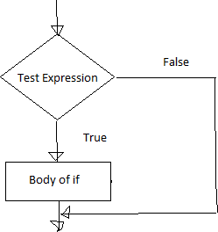
if Statement Flowchart:

Slide 4
Example: Python if Statement
1)
a = 3
if a > 2:
print(a, "is greater")
print("done")
Output:
3 is greater
Done
2)
a = 1
if a < 0:
print(a, "a is smaller")
print("Finish")
Output:
Finish

Slide 5
Else statement:
An else statement can be combined with an if statement. An else statement contains the block of code (false block) that executes if the conditional expression in the if statement resolves false.
Syntax of if - else :
if test expression:
Body of if stmts
else:
Body of else stmts

Slide 6
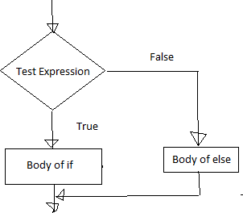
Else statement flowchart:

Slide 7
Example of if - else:
a=int(input('enter the number:'))
if a>5:
print("a is greater")
else:
print("a is smaller than the input given")
Output:
Enter a number:4
a is smaller than the input given

Slide 8
Elif statement:
> The elif statement allows us to check multiple expressions for TRUE and execute a block of code as soon as one of the conditions evaluates to TRUE.
>Similar to the else, the elif statement is optional.
there can be an arbitrary number of elif statements following an if.
Syntax of if – elif - else :
If test expression:
Body of if stmts
elif test expression:
Body of elif stmts
else:
Body of else stmts

Slide 9
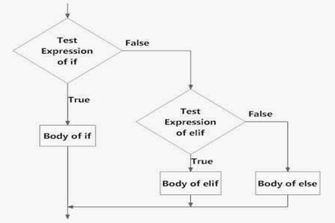
Flowchart of if – elif - else statement:

Slide 10
Example of if - elif – else:
a=int(input('enter the number a:'))
b=int(input('enter the number b:'))
c=int(input('enter the number c:'))
if a>b:
print("a is greater")
elif b>c:
print("b is greater")
else:
print("c is greater")
Output:
Enter the number a: 3
Enter the number b:5
Enter the number c:9
c is greater

Slide 11
THANK YOU

